Slide 1
Security Incident Ingestion & Notification System
Incident Processing & Notification System

Slide 2
Workflow Design
Step 1 → Step 2 → Step 3
Step 1: Ingest Incident Data Collect incidents from RSS feeds, APIs, or monitoring tools Store raw incident payload
Step 2: Validate & Enrich Data Validate required fields (id, title, timestamp) Enrich with severity, category, and source metadata
Step 3: Store & Notify Save processed incident to database Send notification to predefined channels (email/Slack)

Slide 3
Agent-Based Redesign (Dynamic Decisions)
An agent has a goal, evaluates the situation, and decides which tools to use.
Agent Reasoning (LLM Thinking) The agent evaluates: Incident severity, Source reliability, Business impact and Urgency of response
Agent Tools: validate_data_tool, severity_classifier, enrichment_api, send_email, send_slack, escalation_service

Slide 4
Dynamic Agent Behavior
1. Critical Incident
Use validate_data_tool
Use enrichment_api
Use escalation_service
Send Slack + Email alert
2. Low-Priority Incident
Validate basic fields
Store incident
Add to daily summary email

Slide 5
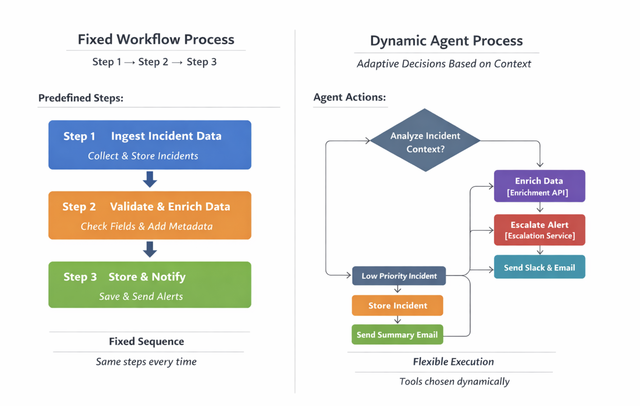
Core Difference
When to Use Each
Workflow: Always do Step 1 → Step 2 → Step 3
Agent: Given this situation, I’ll choose the right tools and actions
Use Workflow when: Steps never change Compliance and predictability matter Errors must be deterministic
Use Agent when: Inputs vary frequently Decisions depend on context Human-like judgment is needed

Slide 6
